Slide 1
Health and Wellness
Decision Making

Slide 2
Warm-up
Write down 2 things that you do not like.
Do you have “friends”? Why or why not?
Notes:
Spring 2017 1/18;

Slide 3
Warm -up
If you had an important decision to make what steps would you take to make that decision? What would you think about or consider?

Slide 4
Warm-up
Give me two examples of how paying attention to only one side of your health triangle will cause you to have an unbalanced triangle.

Slide 5
Warm-up
What online rules do you have from parents or set for yourself? If you do not have any online rules what rules do you believe are appropriate for online usage?

Slide 6
Warm-up
Consider the 6 risk factors for people under 24: Alcohol and drug use, injury and violence, tobacco use, poor nutrition, physical inactivity, and irresponsible sexual activity. Which do your believe is a real concern within your community?

Slide 7
Chapter 1 Vocabulary
Health – the combination of physical, mental emotional, and social well-being
Wellness – an overall state of well being or total health
Risk behavior – actions that can potentially threaten your health or the health of others
Abstinence – a deliberate decision to avoid high-risk behaviors, including sexual activity and the use of tobacco, alcohol, and other drugs
Healthy People – a nationwide health promotion improving the health of all people in the United States

Slide 8
Assignment
Read Cases that were handed out to you
As a group discuss each case
Answer the 4 discussion questions. Write out answers on a sheet of paper to turn in
What was the bad decision that was made?
What were the results of their decision?
How could they have made better decisions?
What would you have done differently?

Slide 9
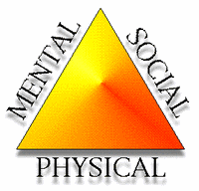
1.1 Your health triangle
There are three areas of health:
Physical health
Mental/emotional health
Social health
Its important to pay attention to all 3 areas of your health triangle
Too much focus on one side causes an unbalanced triangle

Slide 10
1.1 your health triangle
Physical health
Is all about how well your body functions
A high level of physical health includes having enough energy to perform your daily activities, deal with everyday stresses, and avoid injury
For a healthy body
Get 8-10 hours of sleep
Eat nutritious meals and drink 8 cups of H2O daily
30-60 mins of physical activity daily
Avoid tobacco, alcohol, and other drugs
Bathe daily, floss and brush teeth daily

Slide 11
1.1 your health triangle
Mental/Emotional Health is about your feelings and thoughts
A reflection of how you feel about yourself
How you meet the demands of daily life
How you cope with the problems that occur in your life
Being Mentally and emotionally healthy include:
Enjoy challenges that help you grow
Accept responsibility for your actions
Have a sense of control over your life
Mental/emotional health includes spiritual health

Slide 12
1.1 your health triangle
Social Health is getting along with others
Your social network include: family, friends, teachers, and other members of your community
Social health involves:
Seeking and lending support when needed
Communicating clearly and listening to others
Showing respect and care for yourself and others
Keeping the balance
When your triangle is balanced you have a high degree of wellness – an overall state of wellbeing or total health

Slide 13
1.2 What Affects your health
Influences on your health
Factors such as heredity, environment, attitude, behavior, media, and technology can influence how you live
Understanding these influences will help you make informed decisions about your health

Slide 14
1.3 Identifying health risks
Recognizing risk behaviors: CDC Centers for Disease Control and Prevention has identified 6 risk behaviors among young people under 24
Tobacco use
Unhealthy dietary behaviors
Inadequate physical activity
Alcohol and other drug use
Sexual behaviors that may result in HIV infection, other sexually transmitted diseases, and unintended pregnancies
Behaviors that contribute to unintentional injuries and violence

Slide 15
1.3 How to avoid or reduce risks
Abstaining from High-Risk Behaviors
Abstinence a deliberate decision to avoid high-risk behaviors, including sexual activity and the use of tobacco, alcohol, and other drugs
All areas of your health triangle benefit when you choose to abstain from high-risk behaviors
Ex. If you avoid tobacco, alcohol, and other drugs, you protect yourself from the chronic diseases associated with using these substances

Slide 16
1.3 Promoting your health
Lifestyle factors are the personal habits or behaviors related to the way a person lives
Lifestyle factors that can improve a person’s level of health include:
Getting 8 hrs of sleep each night
Starting each day with a healthy breakfast
Eating a variety of nutritious foods each day
Being physically active for 30 to 60 minutes most days of the week
Maintaining a healthy weight
Abstaining from smoking or using other tobacco products
Abstaining from the use of alcohol and other drugs

Slide 17
Building Health Skills
Health skills are specific tools and strategies to maintain, protect, and improve all aspects of your health
Health skills are also called life skills
Health Skill | Benefit to Your Health
Communication | Share ideas and feelings, listen carefully
Refusal | You say no to unhealthy behaviors
Conflict Resolution | You resolve problems with others in healthy ways
Accessing Info | Locate valid sources of health info, products, services
Analyzing Influence | Understand the many influences on your health, including peers, family, culture, media, technology
Practicing Healthful behavior | Act to reduce risks and protect yourself against illness and injury
Stress Management | Use healthy ways to reduce and manage stress
Advocacy | Work to improve your health, family, community health
Decision Making | Use a step-by-step process to evaluate your options
Goal Setting | Set goals and develop a plan to achieve those goals

Slide 18
2.1 Communication Skills
Three health skills
Interpersonal communication
Refusal skills
Conflict resolution
All deal with how you give and receive info
Communication deals with
choosing your words and expressions to clearly say what you really mean
Listen closely to others
Interpersonal communication is the exchange of thoughts, feelings, and beliefs between two or more people
Helps you build strong relationships with others

Slide 19
2.1 communication skills
Strengthen your interpersonal communication skills by:
Use “I” messages to express your feelings. Ex. I feel upset when…
Communicate with respect and caring. Keep voice calm and use respectful tone
Be an active listener. Pay attention to what others are saying. Let him speak without interruption. Try to understand his point of view
Refusal skills help you say no
Developing strong refusal skills helps you say no firmly, respectfully, and effectively
Someone try to get you to ride in a car with them when they have been drinking, use your refusal skills

Slide 20
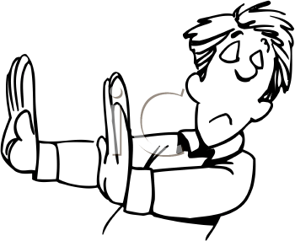
2.1 Figure 2.2 Refusal Strategies
These refusal strategies can help you say no to potentially harmful activities:
Say NO in a firm voice. Do this calmly and clearly.
Explain why. State your feelings. Tell the other person that goes against your values and beliefs
Offer alternatives. Suggest a safe, healthful activity to do instead of the one offered
Stand your ground. Make it clear that you don’t intend to back down from your position
Leave if necessary. If the pressure continues, simply walk away

Slide 21
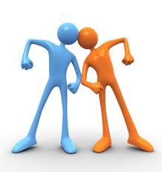
2.1 Communication skills
Conflict-resolution skills is the ability to end a conflict through cooperation and problem solving
Help people resolve problems in ways that are agreeable to everyone involved
Conflict-resolution skills include
Stepping away from an argument
Allow the conflict to subside
Using good interpersonal communication skills
Maintaining an attitude of respect for yourself as well as the other person
Sometimes a compromise is needed

Slide 22
2.1 Accessing Information
Knowing how to find and evaluate health information will help you make decisions
To decide whether health information is valid you need to determine the reliability of the group sharing the information
Valid sources include
Health care providers and professionals
Valid internet sites, such as government agencies and professional health organizations
Parent, guardians, and other trusted adults
Recently published material written by respected well-known science and health professionals
Internet sites: .gov, .org, .edu

Slide 23
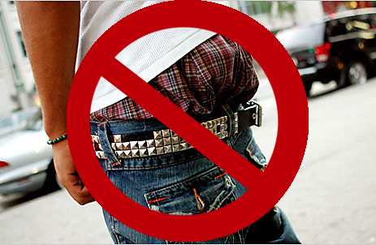
2.1 Analyzing Influences
Do you ever think about why you do the things you do?
Many factors can influence our decisions and actions
Figure 2.3 identifies some examples of influences on our behavior

Slide 24
2.1 Figure 2.3 Influences on Your health
Many factors influence your health | Which sources have the most influence on you?
Personal Values Things I think are important Likes and dislikes Skills and talents | Your family and Culture Beliefs, behaviors, and habits Family traditions Food served at home
Personal Beliefs Plans for the future Goals Hopes and dreams | Media and Technology TV and movies Magazines Internet
Perceptions Behaviors that I think are common or accepted | Friends and Peers Behaviors and opinions of my friends and classmates
Curiosity/Fears Things I wonder about Things that scare or frighten me Things I want/don’t want to try | School and Community Place where I live School I attend Air quality Sources or recreation

Slide 25
Self-management skills
Taking charge of your own health
When you manage your behavior you act in ways that protect your health and promote your own well-being
Two self-management skills
Practicing healthful behaviors – done when you make good health habits part of everyday life
Managing Stress – stress is the reaction of the body and mind to everyday challenges and demands
Stress managements skills are important because they help you reduce and manage stress in your life
Exercising, relaxation, and managing time efficiently are some effective ways to manage stress

Slide 26
2.2 Making Responsible decisions and setting goals
Decision Making
People face decisions every day. Some choices are pretty easy to make and others are more difficult
Lifestyle – Your way of living. This could affect your health more than any other factor
Consider your Values – ideas, beliefs, and attitude about what is important that help guide the way you live. Values allow you to choose between good and bad, and between right and wrong.

Slide 27
2.2 Decision Making
The Decision-making Process
Decision-making skills are steps that enable you to make a healthful decision
The HELP strategy includes asking yourself the following
H (Healthful) Does this choice present any health risks?
E (Ethical) Does this choice reflect what you value?
L (Legal) Does this option violate any local, state, or federal law
P (Parent Approval) Would your parents or guardians approve of this choice?

Slide 28
Decision-making process
Steps of the Decision-Making Process
State the Problem – “Should I go to the party even though I don’t want to drink?”
List the Options – Before making a decision take a look at your other options. Go to the party and refuse a drink if it is offered Stay home and watch reruns of “A Different World.”
Imagine the Benefits and Consequences – Make a list of the short-term and long-term benefits.
Consider your Values – A responsible decision will reflect your values
Weigh the Options and Decide – Make a decision by thinking of your options. Always think of how your options fit your values.
Evaluate the results –Ask yourself these questions: How well did the decision work out? How well did you identify the potential benefits and negative consequences of the option you chose? How can you improve the way you make decisions in the future?

Slide 29
Assignment
Choose a decision that you have to make in your future (Ex. College, military, marriage, etc.)
Use the steps from the decision making process to help you make your decision
Write out every step and every option for your decision

